Slide 1

PrognosAI – AI-Driven Predictive Maintenance System
Infosys Springboard 6.0
Presented by: Rakesh Pedapudi
Tech Stack: Python · Pandas · TensorFlow · Streamlit

Slide 2

The Challenge: Unexpected Equipment Failures
Critical Pain Points
Industries worldwide struggle with unexpected equipment failures that cascade into significant operational challenges.
Unplanned downtime halts production lines
Emergency repairs drive up maintenance costs
Safety risks endanger personnel and assets
Revenue loss from operational disruptions
Traditional reactive maintenance is no longer sustainable in competitive markets.

Slide 3






The Solution: AI-Powered Predictive Intelligence
Early Failure Detection
Real-Time Monitoring
Proactive Maintenance
Machine learning algorithms analyze sensor patterns to predict failures before they occur
Continuous analysis of time-series sensor data enables accurate, actionable alerts
Transform from reactive repairs to scheduled interventions, reducing costs and risks
PrognosAI leverages advanced neural networks to deliver predictive maintenance that keeps operations running smoothly.

Slide 4
Project Roadmap
01
02
ML Pipeline Development
Data Preprocessing
Build comprehensive machine learning infrastructure from data ingestion to model deployment
Clean and transform sensor data to ensure model accuracy and reliability
03
04
Neural Network Training
Evaluation & Analysis
Develop and optimize deep learning models for failure prediction
Perform rigorous testing including bias analysis and performance metrics
05
06
Alert System Integration
Dashboard Deployment
Generate intelligent alerts based on configurable thresholds
Deploy interactive Streamlit dashboard for real-time monitoring

Slide 5




Milestone 1: Data Preparation Excellence
Data Pipeline
Sample Sensor Data
Load Data
sensor_1
sensor_2
sensor_3
target
Import training and testing CSV files from sensor systems
42.35
23.18
518.67
0.87
42.89
23.45
521.32
0.92
Quality Check
41.92
22.87
515.43
0.78
Identify missing values and data anomalies
43.12
23.76
522.89
0.95
Data Cleaning
Clean, structured data forms the foundation for accurate predictive models.
Remove null rows and normalize sensor readings
Ready for Training
Cleaned datasets prepared for model development

Slide 6

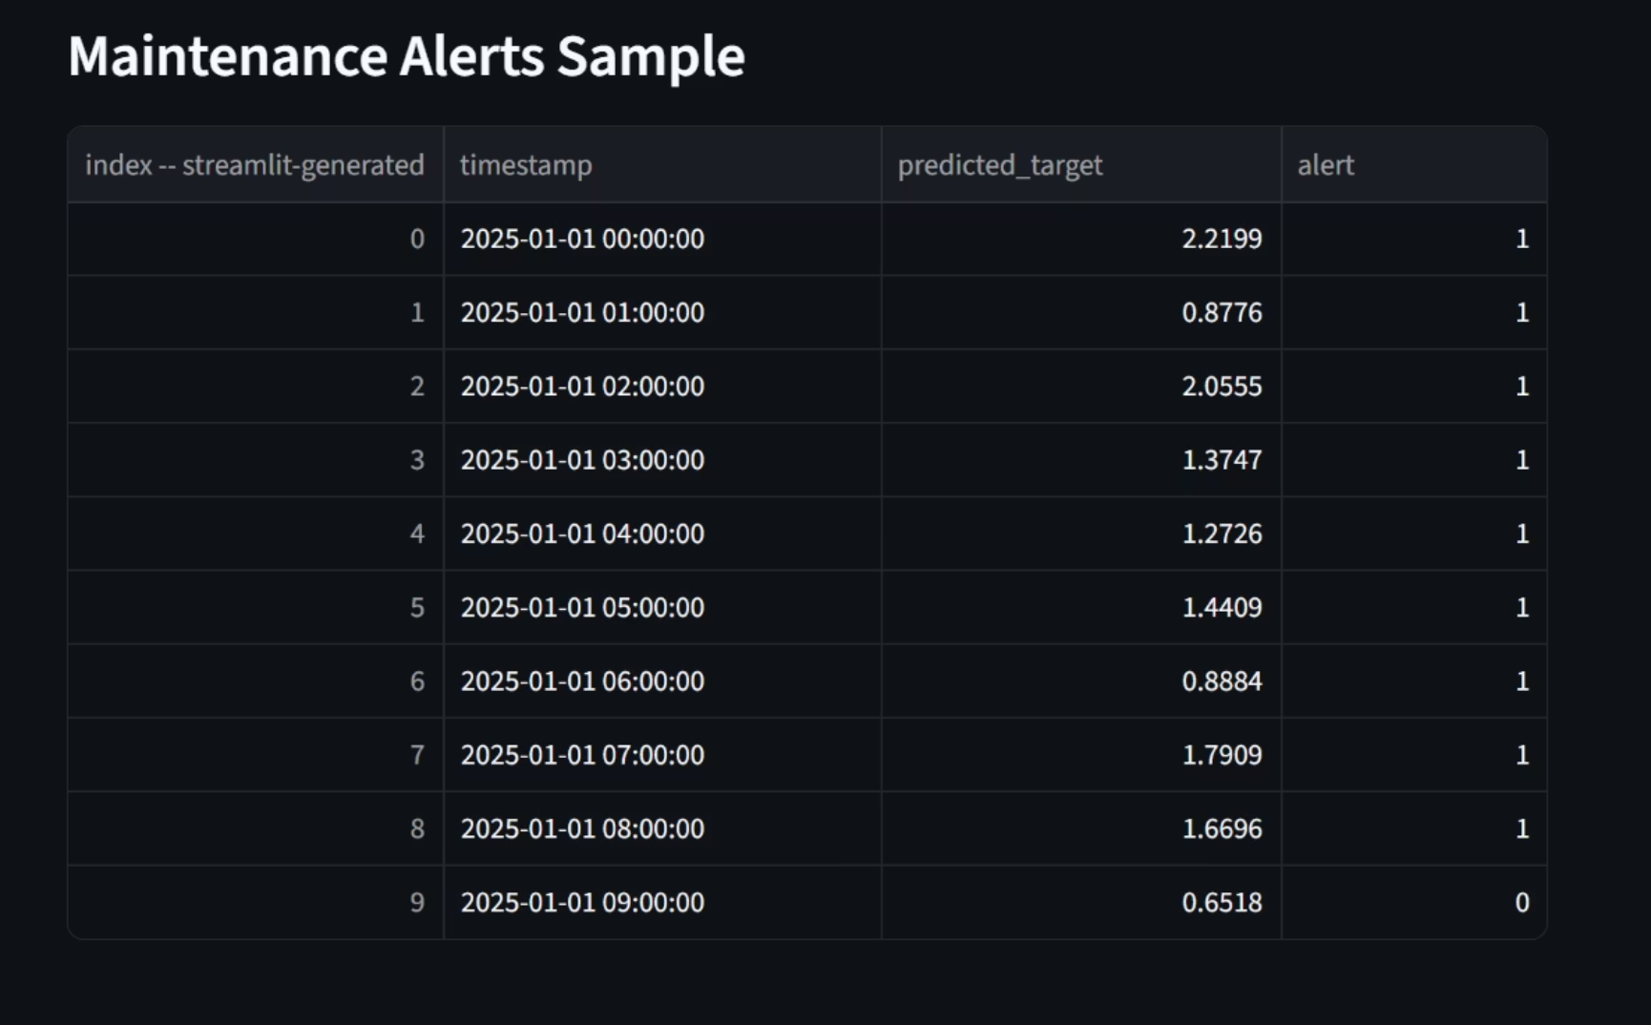
Milestone 2: Neural Network Architecture
1
2
3
Network Design
Training Configuration
Validation Strategy
Architecture: 64-64-1 dense layers
Loss Function: Mean Squared Error
Split: 20% validation set
Activation: ReLU for non-linearity
Optimizer: Adam with adaptive learning
Checkpoint: Save best performing model
The model converges efficiently, demonstrating stable learning and strong predictive capability across validation data.
Each alert entry highlights the exact timestamp at which the model detected abnormal behavior, making it easier for maintenance teams to trace issues back to specific operational periods. By monitoring these alerts over time, users can observe recurring patterns, identify potential failure windows, and schedule interventions before the equipment reaches a critical failure point. This not only reduces unplanned downtime but also improves the overall reliability and efficiency of the predictive maintenance workflow.

Slide 7
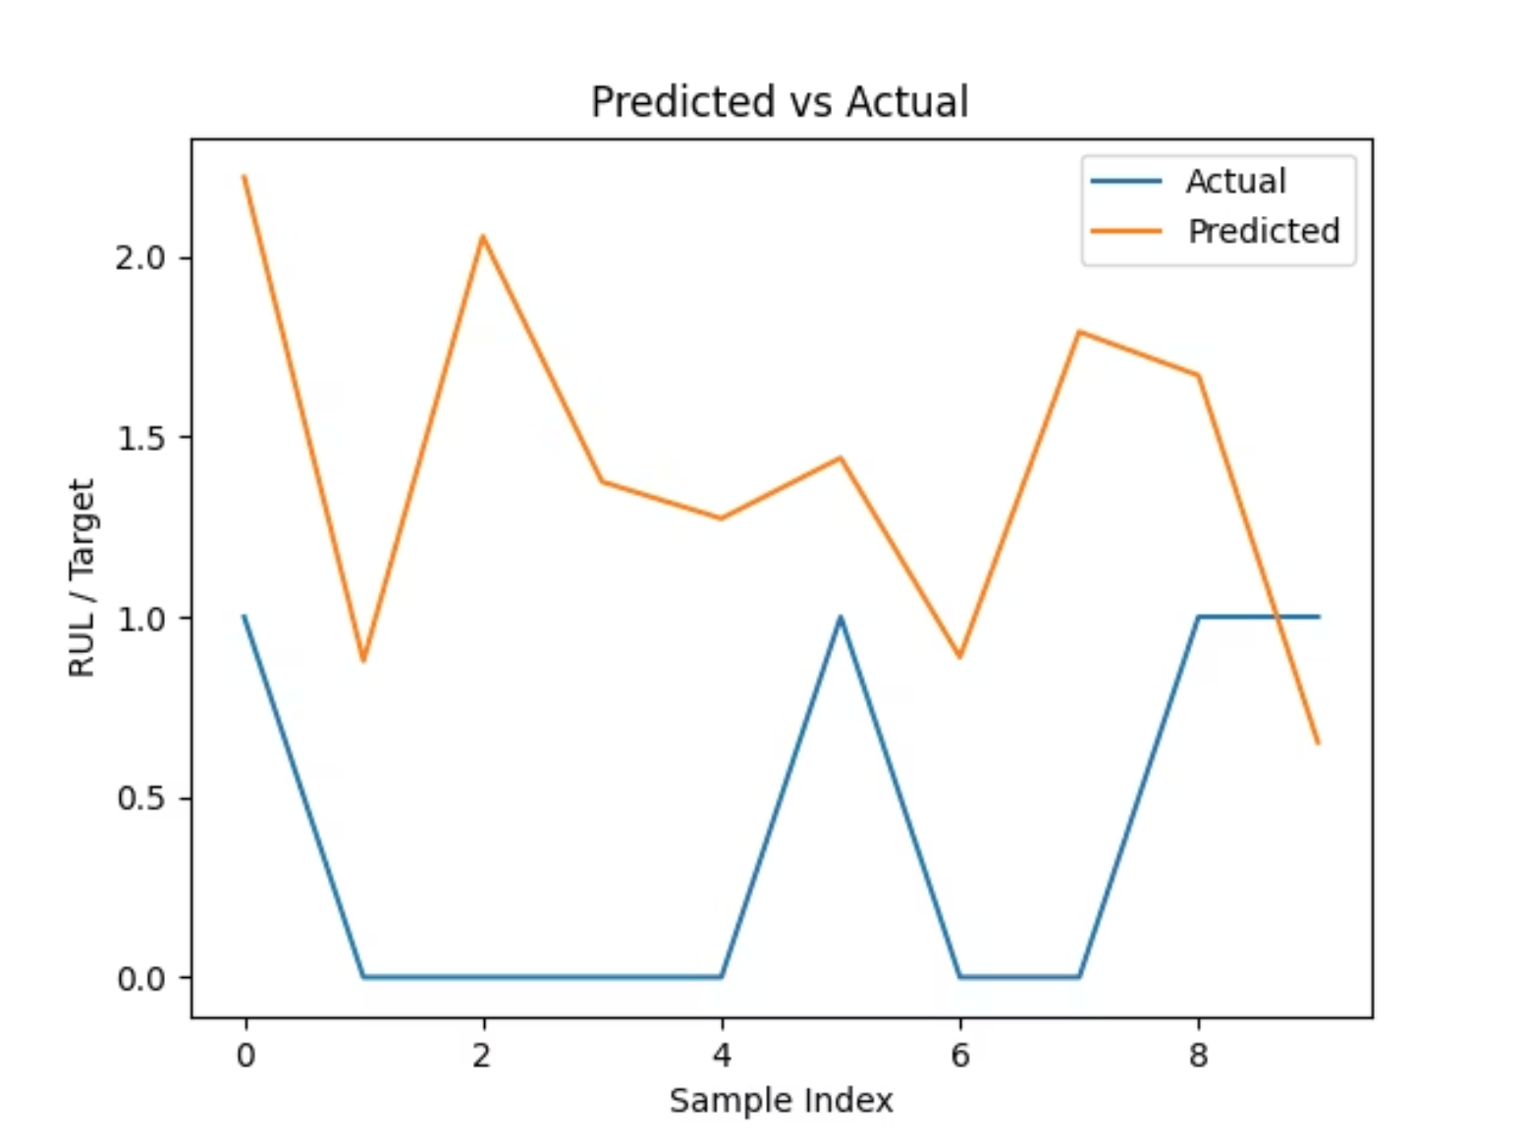
Milestone 3: Model Performance Analysis
Evaluation Metrics
0.76
Low
R² Score
RMSE
Strong correlation between predictions and actual values
Root Mean Squared Error indicates high accuracy
Low
MAE
Mean Absolute Error confirms consistent performance
Comprehensive analysis including residual distribution and trend visualization confirms the model's reliability for production deployment.

Slide 8


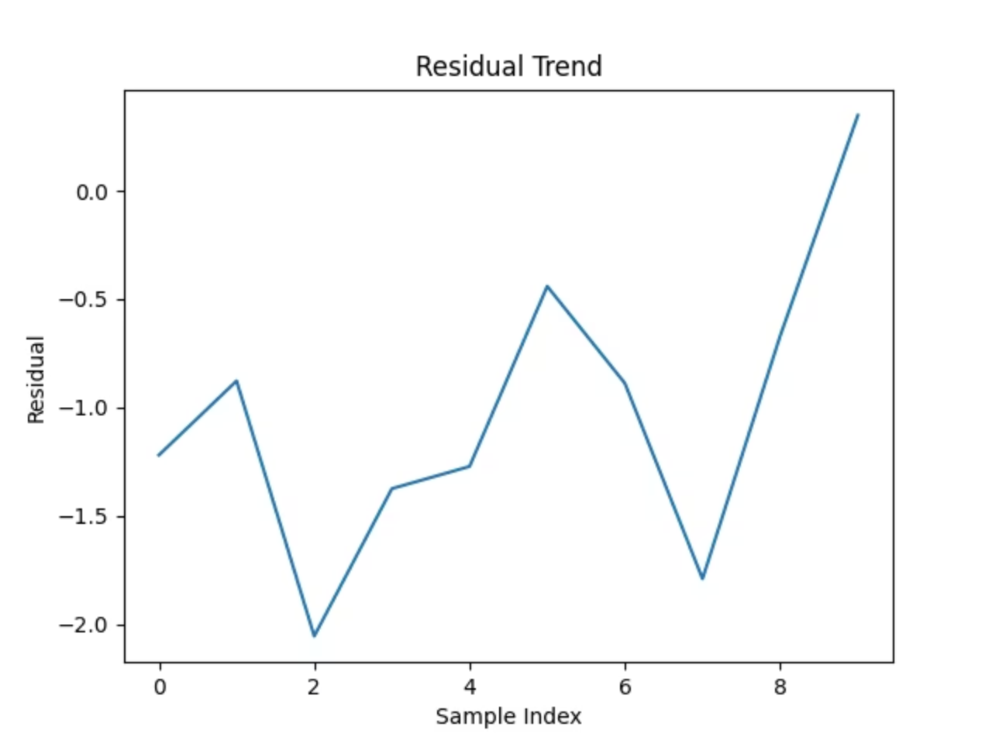


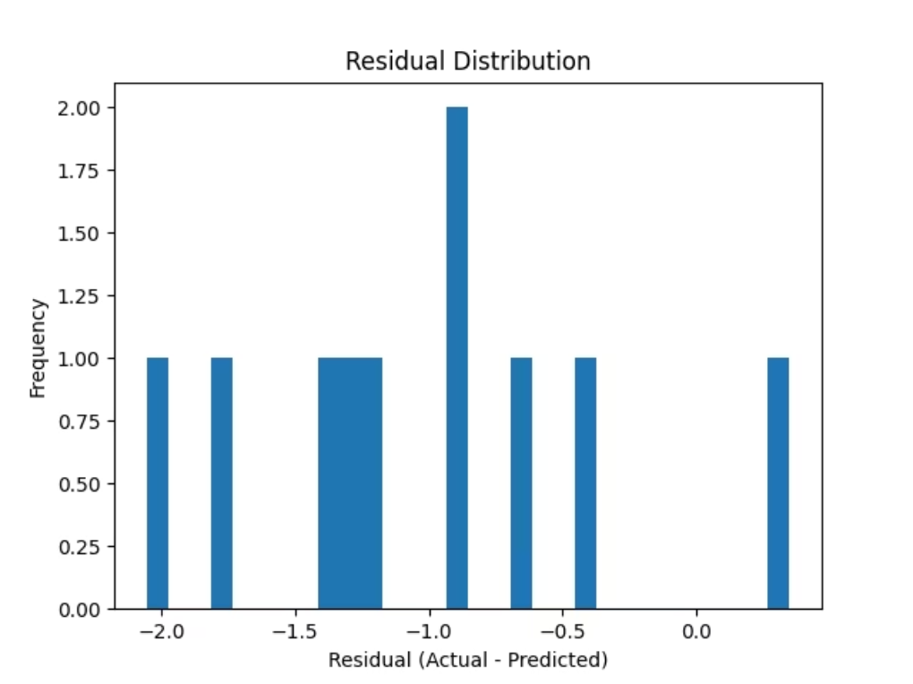
Interactive Streamlit Dashboard
Remaining Useful Life (RUL) Trends
Real-time visualization of equipment health trajectories over time, enabling proactive maintenance planning
Performance Metrics Display
Live tracking of RMSE, MAE, and R² scores to monitor model accuracy and reliability
Interactive Visualizations
Dynamic charts and graphs allowing stakeholders to explore data patterns and trends intuitively

Slide 9
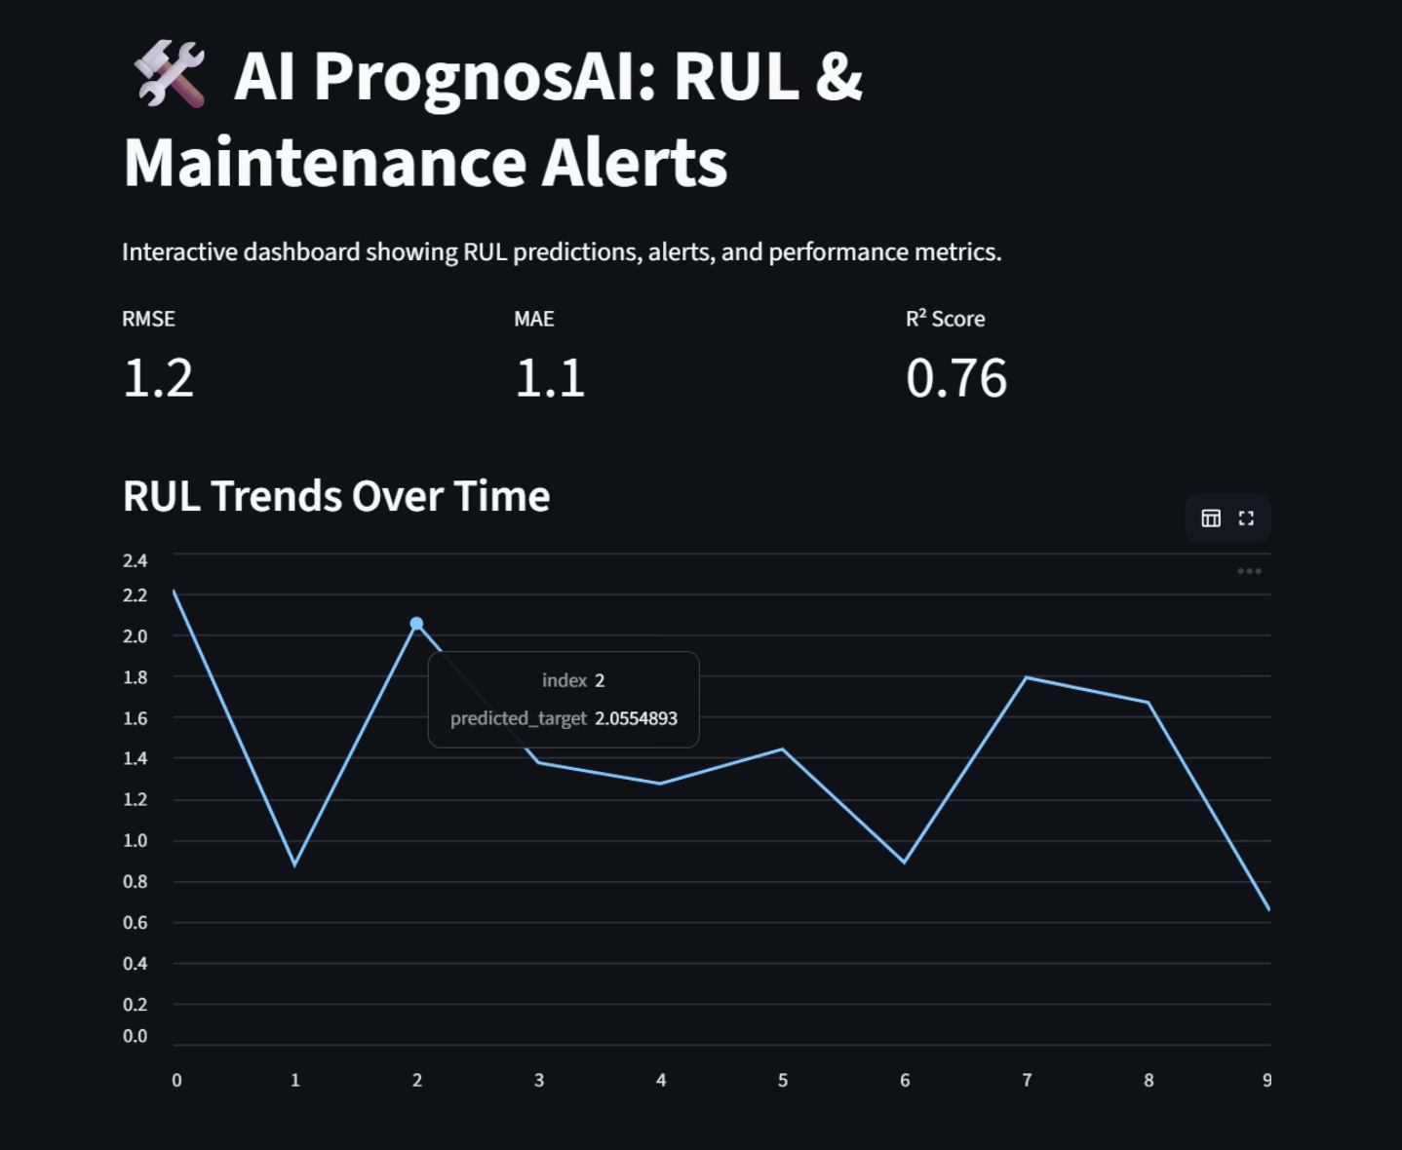
Intelligent Alert System
Model Performance Overview
The dashboard provides a real-time view of the model’s performance using key evaluation metrics such as RMSE, MAE, and R² Score. It visualizes Remaining Useful Life (RUL) trends over time, helping identify potential failure points early. The interface enables quick interpretation of predictions and allows users to monitor equipment health more effectively.
Automated threshold monitoring generates immediate alerts when equipment shows signs of impending failure.
1
Detection
2
Evaluation
Model identifies anomaly patterns
Compare prediction against threshold
3
Alert Generation
4
Action
System triggers maintenance notification
Team schedules proactive intervention

Slide 10

Impact & Future Vision
Key Achievements
Future Enhancements
End-to-end predictive maintenance system deployed
Achieved 76% R² score with stable accuracy
LSTM Integration
Streamlit dashboard simplifies monitoring
Advanced sequence modeling for temporal patterns
Automated alert system enables proactive decisions
Reduced downtime and maintenance costs
Feature Expansion
Incorporate additional sensor types and environmental data
Cloud Deployment
Real-time streaming with scalable cloud infrastructure

